Slide 1
DIGITAL LITERACIES
BY
GBENGA-OWOYEMI, BUSAYO R.
ACADEMIC STAFF TRAINING
GENERAL STUDIES UNIT
FEDERAL UNIVERSITY OF TECHNOLOGY, AKURE

Slide 2
INTRODUCTION
The word ‘literacy’ has evolved over the years from just being able to read and write. It has evolved to accommodate the peculiarities of the twenty-first century.
As communication and access to information keep increasing through technologies like the internet, social media and media devices, you cannot be considered literate until you are digitally literate.

Slide 3
What are Digital Literacies?
Digital literacies may mean different things to different people across contexts, but generally, they involve the capabilities which fit an individual for living, learning and working in a digital society.

Slide 4
According to the American Library Association (ALA), digital literacy is the ability to use information and communication technologies to find, evaluate, create and communicate information requiring both cognitive and technical skills. American Library Association (2013)
According to Jisc (2014), they are sets of academic and professional situated practices supported by diverse and changing technologies.

Slide 5
Why is digital literacy so important?
Today, there is an increasing level of focus on the benefits of the internet as a main source of information, the importance of the internet as a digital tool in education cannot be overemphasized.
Moreso, to be relevant as an academic, you need to be digitally literate so as be able to confront the challenges of teaching and learning in the 21st century.

Slide 6
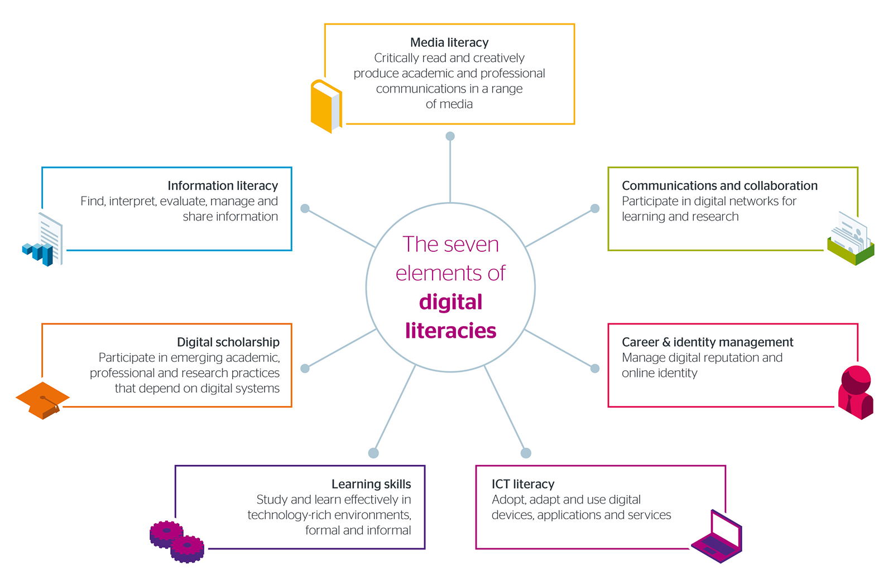

Slide 7
WHAT ARE DIGITAL LITERACY CAPABILITIES?
Media Literacy
Information Literacy
Digital Scholarship
Learning skills
Communications and collaborations
Career and Identity management
ICT literacy

Slide 8
Media Literacy
Media literacy is being able to critically read and creatively produce academic and professional communications in a range of media.

Slide 9
Specifically, these are questions to ask:
Who created this?
Why did they make it?
Who is the message for?
What techniques are being used to make this message credible or believable?
How did the message make you feel?

Slide 10
Media literacy helps us to:
Learn to think critically
Become smart consumers of products and information
Recognize points of view
Create media responsibly
Identify the role of media in our culture
Understand the author’s goal

Slide 11
Information literacy
. Being able to find, interpret, evaluate, manage and share information.
To be information literate, a person must be able to recognize when information is needed and have the ability to locate, evaluate and use effectively the needed information.

Slide 12
Digital Scholarship
Participate in emerging academic, professional and research practices that depend on digital systems.
Digital scholarship is the effort to establish digital media and social media as a credible, professional and legitimate means of research and communication.

Slide 13
Learning Skills
Study and learn effectively in technology rich environments, formal and informal

Slide 14
Communications and collaboration
Participate in digital networks for learning and research

Slide 15
Career and identity management
Manage digital reputation and online identity.
This involves creating strong passwords, understanding and using privacy settings, etc.

Slide 16
ICT literacy
Adopt, adapt and use digital devices, applications and services

Slide 17
Conclusion
With the different digital literacies highlighted, please note that learning any skill requires time, effort and discipline, the same goes for digital literacy skills, the room for growth is allowed even as the skills evolve too. But the first requirement is to start learning the skills. Not only should you have these skills, you should also be able to guide and support your students in having these skills.

Slide 18
