Slide 1
Employability Skills
By
B. K. ALESE, PhD
Professor of Information and Cyber security

Slide 2
INTRODUCTION
Every year 600,000 students in the Nigeria graduate with a degree: what makes you stand out?
Whether you are studying for an English, history, business or engineering degree, the one thing you will all have in common is the fact that you all need to know how to market yourself If your goal is to secure employment at the end of your degree or to start your own business, you will need to be able to convince a potential employer or investor that you are the perfect candidate.

Slide 3
Marketing and graduate development
Marketing is often seen as a business-related activity, but it is essential for every successful graduate.
While at university you are developing your own individual brand.
When employability is viewed in its crudest form, we are all products attempting to sell our skills in the graduate marketplace.

Slide 4
What do we mean when we talk about employability?
Employability is a set of achievements skills, understanding and personal attributes that makes graduates more likely to gain employment and be successful in their chosen occupations, which benefits themselves, the workforce, the community and the economy (Mantze-Yorke, 2006).

Slide 5
What do we mean when we talk about employability? Cont…
A set of attributes, skills and knowledge that all labour market participants should possess to ensure they have the capability of being effective in the workplace to the benefit of themselves, their employer and the wider community (CBI, 2011)

Slide 6
Employability Skills
Self-management
Communication and literacy
Team-working
Application of numeracy
Business and customer awareness
Application of Information Technology (IT)
Problem-solving
Positive attitude
Entrepreneurship/enterprise.

Slide 7
Self-management
Are you good with meeting deadlines? Are you organized? Do you use your own initiative?
If you can answer yes to these questions that’s great, but if you can’t manage yourself how can employers expect you to manage at work?
Employers will expect you to be organized, punctual, working to deadlines and a self-starter.
How you manage yourself and your approach to your work is key to being employable.
Your first management role is self-management.

Slide 8
Teamworking
What do Barcelona FC, the United Nations and Great Ormond Street Hospital have in common?
They all achieve success through teamwork.
Each member of the team plays a vital role, and that ensures their success.
Why is teamworking important?

Slide 9
Teamworking Cont..
So why is teamworking important?
In today’s rapidly changing marketplace, organisations are faced with challenges, which can not be addressed by one department.

Slide 10
Teamworking Cont..
The challenge affects the organisation as a whole, and so teams are drawn from both across functions, but also globally.
When devising solutions an organisation will need to have the knowledge from within its organization and possibly from an expert consultant drawn from within its particular sector.

Slide 11
Teamworking Cont..
Developing teamworking skills
University is the perfect place to develop teamworking skills.
Often students work part time, which presents the opportunity to develop teamworking skills in a live environment, and the experience will enhance many other employability skills such as communication

Slide 12
Problem-solving
The CBI defines problem-solving as “analysing facts and situations and applying creative thinking to develop appropriate solutions”.
Organisations continually face challenges from advancing technology, competitors and changing markets so they need employees who can develop innovative solutions that will keep them ahead of the competition.
Graduates who are creative, innovative and use their own initiative are essential to developing solutions to the challenges of the future.

Slide 13
How do you develop problem-solving skills?
Identify the problem.
What are the essential elements of the problem?
Define the problem through thinking about it and sorting relevant information.
Explore solutions.
What are the advantages and disadvantages of each solution?
Act on strategies.
Look back and evaluate the effects of your activity.

Slide 14
Communication
Communication in essence is the sending of a message by sender A to receiver B. The format of the message can take different forms and the language will vary depending on the context. There are several different options available.
Face to face
Despite face to face appearing to be the easiest form of communication, messages can still be misinterpreted by the choice of words, body language, tone and the person delivering the message.

Slide 15
Communication Cont…
Telephone call
Without the aid of visual expression, the choice of words and tone become even more crucial to ensure the receiver interprets the message accurately. Telephone interviews are often used during the selection process, and students would be advised to practice beforehand, as diction, tone and clarity are paramount.

Slide 16
Communication Cont…
Written communication
Written communication can take various form, including CVs, reports and covering letters. The style of writing, presentation and choice of words can all affect the way the message is delivered and received

Slide 17
Communication Cont…
Social media
Twitter, WhatsApp, LinkedIn, Facebook and instant messaging can be misinterpreted due to the incorrect use of upper or lower case, the insertion of an emoticon or an abbreviation.
Although it is an accepted means of communication, it is heavily criticised if not used in the right context.

Slide 18
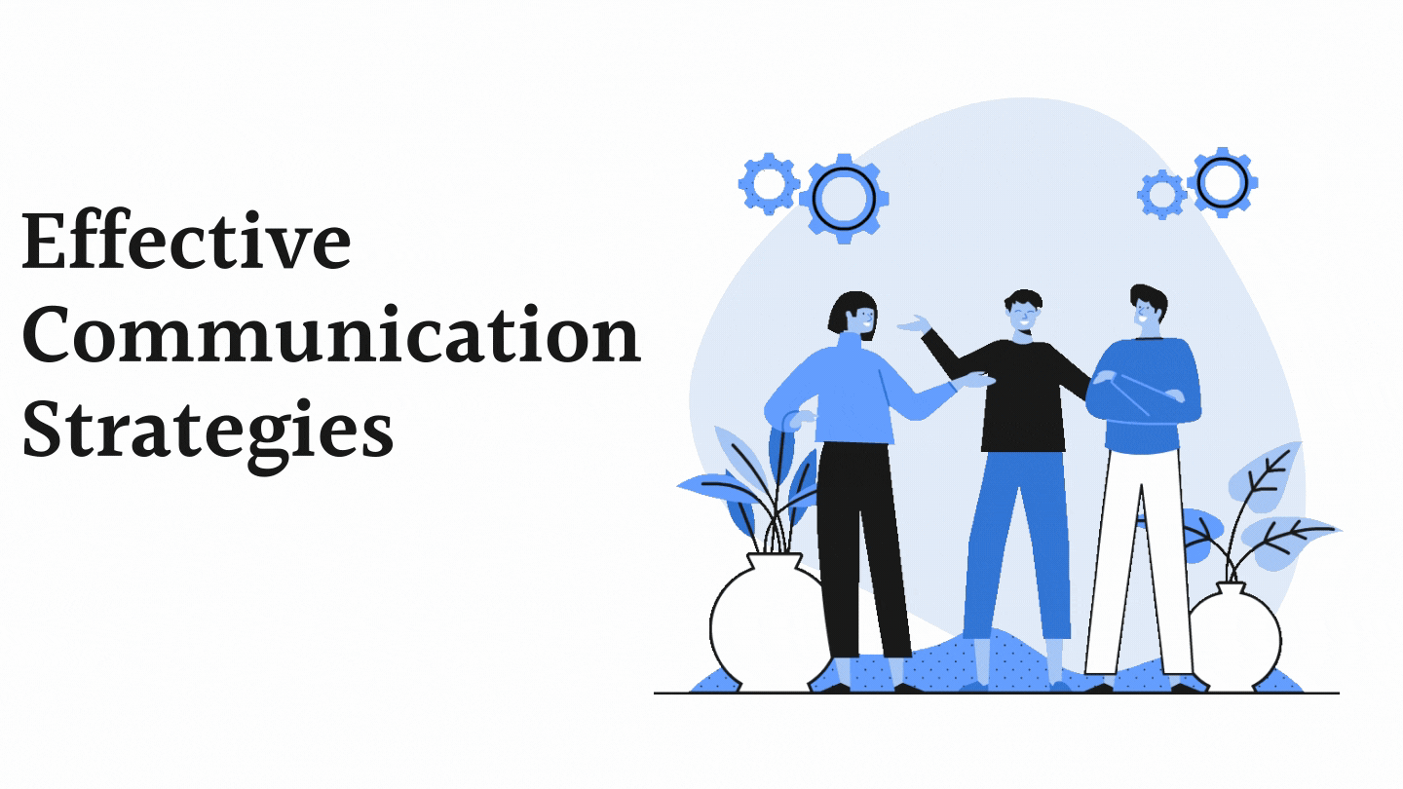
Communication Cont…
Effective communication
So how can we communicate effectively? When delivering a message, you need to take into account the context. In what context is the message being delivered? Professional, academic or social.
The mode of delivery should reflect the context along with the choice of words.

Slide 19
Communication Cont…
In addition, to avoid any confusion use the 7Cs of communication
Clear: Ensure the aim and purpose of your message is clear from the outset of your written or verbal communication.
Concise: Less is more when communicating so be brief and targeted.
Concrete: Be focused in your communication and ensure that you are specific, factual and provide the required level of detail.
Correct: Ensure that your spelling, facts and grammar are correct. Also ensure that the tone, language and choice of words fit the context.
Coherent: Reread your message to ensure that it is logical and your ideas flow smoothly.
Complete: Ensure your communication contains the necessary information required by the receiver to respond.
Courteous: Ensure that you address the recipient politely and appropriately.

Slide 20
Application of IT
Technology is transforming, disrupting and reshaping all industries.
No organisation is insulated from the rapid changes taking place within the technology sector, but it’s the resounding ripples and waves that affect all industries as well.

Slide 21
Application of IT Cont…
The dramatic advances in technology are causing industries to question their purpose in the future. An example of this is the retail banking sector.
There are so many different ways that you can make payments these days; you can pay by email, by Paypal and you can pay by your mobile phone, but all of that relies on the same plumbing and predominately it’s the banks that provide that plumbing. Right now it’s of value to us but I think we are in danger of just becoming the plumbing.’ (Mortimer, 2015).

Slide 22
Application of IT. Cont…
Industries are not just facing change, they are facing disruption.
As a graduate you will be expected to be an IT savvy.
Question how technology could improve your processes or add value to your role.
Continually update your IT skills, undertake short courses to learn about new technologies and new ways of performing tasks

Slide 23
Application Of Numeracy And Data Analysis
How’s your mental mathematics?
Can you analyse data and provide the best course of action?
Are you financially literate?
When was the last time you calculated an average, percentage or fraction?

Slide 24
Application Of Numeracy And Data Analysis
Well, all of these Maths elements can and do feature in selection tests and assessment centres.
Numeracy is like Marmite you either love it or hate it. But either way employers love it.

Slide 25
Leadership
Are you a future leader?
Are you a game changer?
Or are you able to take ownership of a situation and bring it to resolution?
Leadership comes in many forms and varying personalities.
There are some excellent examples of leadership in the public arena from Barack Obama to Steve Jobs, but on a daily basis many employees within organisations demonstrate leadership skills.

Slide 26
Enterprise
In today’s competitive market, regardless of the sector or role that you are recruited into, employers want graduates who are not afraid to disrupt the status quo.
The ability to understand and interpret current processes, and how they are interconnected and interrelated, gives rise to opportunities to identify areas for improvement.

Slide 27
Enterprise Cont…
Being entrepreneurial is not limited to starting your own business; organisations benefit from staff being intrapreneurs, developing new products and processes from within the organisation.
This helps to maintain their competitive advantage.

Slide 28
Emotional intelligence
Businesses continually face challenging, demanding and transforming landscapes, and so workforces need to manage and respond accordingly.
Companies increasingly realise that the emotional intelligence (EI) of their employees plays an important role in determining an individual’s response to a situation or to other people.
As a result, emotional intelligence has become increasingly important when identifying new talent.
The leaders of tomorrow need to develop their ability to remain objective and make decisions based on the facts and data related to the situation.

Slide 29
Four Key Components Of An Individual’s Emotional Intelligence
Self-awareness: The ability to recognise how their feelings will affect their job performance.
Self-management: The ability to demonstrate self-control and remain calm and clear-headed even during highly pressured situations.
Social awareness: The ability to listen to what is said and more importantly what is unsaid and allow this to guide both your interaction with others and your decision-making.
Relationship management: Employees with high emotional intelligence have the ability to inspire, influence, develop others, challenge the status quo and manage conflict

