Slide 1
Students’ Voices:
Listening and Moderating
Facilitation as ‘hanging out with your students’
Fúnmi Olúbọ̀dé-Sàwẹ̀, FUTA

Slide 2
Work it out
Facilitation?
related words?

Slide 3
Different Formats
Small breakout discussions where students work together to answer a critical question as a group assignment.
Students posting their individual responses to a question, and in turn responding to two or three other students.
Creating a thread in the discussion board where you answer frequently asked questions for the week.
Inviting a guest speaker who join your discussion board to interact with the students in a Q&A format.
Each student having a private discussion thread that they use as a journal for the course.

Slide 4
Why have group discussions?
Group discussions serve to promote learner/learner interaction and critical thinking.
Discussions can facilitate a sense of community through interaction with peers and the instructor, through the creation of social presence
Group discussions can also be used for assessment purposes.

Slide 5
Principles for cultivating successful discussions I
Create cultural norms: netiquette, rubrics, introductions
Model the behavior you want students to exhibit
  Encourage participation (constructive, positive, active, and inclusive)
  Frequent instructor participation is beneficial (at first). But focus on getting the students to own the learning space
Build community
  Use students’ names; it makes participants feel they are valuable, part of a community
  Don’t put yourself out as the expert; you are a moderator, a guide
  Monitor the discussion and step in when the conversation is dying/escalating
  Redirect conversations and/or connect students as necessary

Slide 6
Principles for cultivating successful discussions II
Technical concerns
Try a practice post: this can help troubleshoot technical issues.
Set expectations
Be clear with students about how much interaction you can provide
Time management
Online discussions can involve a significant time investment.
Plan how much time you want to invest on online activities

Slide 7
Some examples of facilitation
These examples reflect some errors we have made in our own facilitation journey

Slide 8
Indicators | Examples
Validating student contributions | 1. Good point. While asking a student what you have missed, you miss more. 2. A new discussion is fine, but your topic must begin with: DID YOU KNOW... You also need to provide a source of the information, so that we can confirm it, if we need to. The issues you raised are really important. I suggest you start a new discussion on this same topic on the General forum. Your colleagues from other departments will find it interesting.
Querying student contributions | 1. Hello, Omolola. Do you think merely being able to read and write will serve the needs of a student in today's world? Go over the material we discussed in class on 21st century literacy skills, and respond. 2. Says who? What's the source of this?
Disapproving of student contribution | In future, make your contribution shorter. Simply summarize the ideas you wish to share. (style) 2. Interesting and useful but dishonest. Acknowledge your source. (plagiarism)
Participating in the discussion | Numeracy might not involve complex mathematics. Market women and men are usually numerate enough to put a mark up on the goods they sell to make profit, and would not usually go below that price. Buying yams in bulk, and knowing how many piles of five the bulk can be divided into also involves numeracy. A student, however, needs higher order skills and some statistical ability, to function in a university.

Slide 9
Indicators | Examples
Prompting discussion | Hello, Mary. Do you think merely being able to read and write will serve the needs of a student in today's world? Go over the material we discussed in class on 21st century literacy skills, and respond. 2. You could have kick-started the discussion by sharing your experience and challenges, if any.
Re-directing the discussion | Suppose spacing of students has not curbed examination malpractice. What methods do you think should be adopted? 2. The problem has been thoroughly analysed. How about some solutions? If a serious student feels sleepy during lectures, what can she/he do?
Extending the discussion | To extend this discussion, we need to locate trustworthy sources of information in different media. For a named 100 level course, can we first list the different possible sources of information in different media, and then select those sources you can trust and why.
Closing the discussion | The issues you raised will be brought to the attention of the relevant authorities. On this forum, however, the discussion is closed.

Slide 11
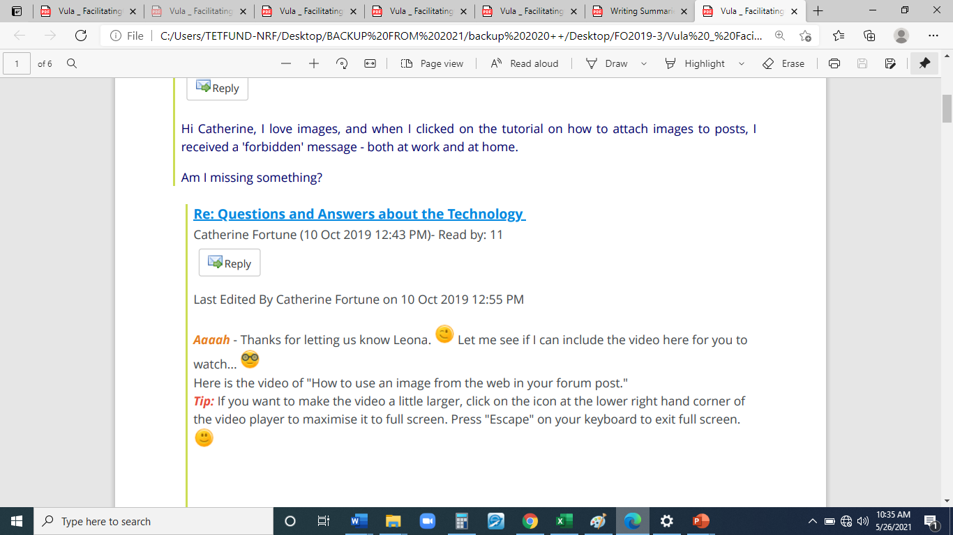

Slide 12
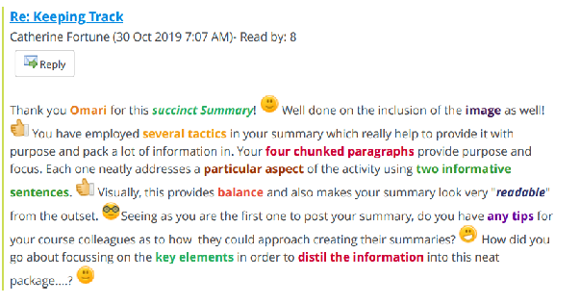

Slide 13
Dealing with criticism
A few weeks into a course you receive the following message from a student:
“One thing that really irritates me is the really loud students who like to dominate discussions and then have the nerve to call those of us who prefer to observe and reflect a bit, before participating "lurkers".
How would you respond to this message?
How would you encourage individuals or groups who seem reluctant to post online, to participate without making them feel as if they are in the spotlight?

Slide 14
Thanks for sharing your perspective. Taking your time to reflect does not make you a lurker: in fact, thinking is the most important part of writing. That is their opinion. Do you know the best way to silence such arrogance? When you have put your thoughts together, you make a response that shames their assumptions: something deep, something intellectually stimulating, something that makes us all go, "WOW!". I know you can. Let's get this show on the road and make our forum exciting place to hang out and cerebrate. FUNMI
Hi Funmi, are you sure that you were not a diplomat or a life coach in a previous career? Thorough approach here which addresses the individual and the community. TONY
Hi Funmi (I've had to offer a reply via Tony's message because my computer seems to do funny things when I tried to reply to your original message) I like the suggestion of a private message directed to the student as well as something more general for all the students. I wonder if the message could be phrased more simply. I'm asking as I had to read it a few times before it became clear to me what you were aiming to do. I do acknowledge that I am extremely tired after a crazy week so not the brightest spark at the moment:-) Kind regards Penny
Thanks, Penny. I understand that the culture-laden reference might have caused some problem to decoding the message. Will try to be clearer when conversing with a multi-cultural audience. FUNMI

